Slide 1
General Motors Company
Q1 2013 Results
May 2, 2013

Slide 2
Forward Looking Statements
In this presentation and in related comments by our management, our use of the words “expect,” “anticipate,” “possible,” “potential,” “target,” “believe,” “commit,” “intend,” “continue,” “may,” “would,” “could,” “should,” “project,” “projected,” “positioned,” “outlook” or similar expressions is intended to identify forward looking statements that represent our current judgment about possible future events. We believe these judgments are reasonable, but these statements are not guarantees of any events or financial results, and our actual results may differ materially due to a variety of important factors. Among other items, such factors may include: our ability to realize production efficiencies and to achieve reductions in costs as a result of our restructuring initiatives and labor modifications; our ability to maintain quality control over our vehicles and avoid material vehicle recalls; our ability to maintain adequate financing sources, including as required to fund our planned significant investment in new technology; our ability to successfully integrate Ally Financial’s International Operations; the ability of our suppliers to timely deliver parts, components and systems; our ability to realize successful vehicle applications of new technology; overall strength and stability of our markets, particularly Europe; and our ability to continue to attract new customers, particularly for our new products.
GM's most recent annual report on Form 10-K provides information about these and other factors, which we may revise or supplement in future reports to the SEC.

Slide 3
First Quarter 2013 Performance
* See Adjusted Automotive Free Cash Flow reconciliation on slide 21
Note: EBIT- Adjusted includes GM Financial on an Earnings Before Tax (EBT) basis

Slide 4
First Quarter 2013 Highlights
GM Financial - Ally International acquisition in process
Record sales in China
Cadillac and Buick resurgence in the U.S.
Vauxhall growing faster than the market in the U.K.
Sales rebounding in Brazil
New vehicle announcements
  Cadillac CTS
  Buick LaCrosse and Regal
  Chevrolet Silverado / GMC Sierra pricing and fuel economy
  Vehicle connectivity – 4G LTE mobile broadband

Slide 5
Summary of Q1 2013 Results
Note: EBIT- Adjusted includes GM Financial on an Earnings Before Tax (EBT) basis
Notes:
Income Statement
EPS worksheet
Cash Flow

Slide 6
Impact of Special Items

Slide 7
Consolidated EBIT- Adjusted
($B)
*
* Excludes China JVs
Note: EBIT- Adjusted includes GM Financial on an Earnings Before Tax (EBT) basis

Slide 8
Consolidated EBIT- Adj. – Q1 2012 vs. Q1 2013
($B)
Q1 2012
$0.4B Decrease
Q1 2013
Note: EBIT- Adjusted includes GM Financial on an Earnings Before Tax (EBT) basis;
Results may not foot due to rounding

Slide 9
Country of Sale Reporting
Beginning Q1 2013 we will report revenue and profitability in the segment in which we sell vehicles to third party customers
  Previously, segment results included the impact of inter-segment sales and profit
  Improves profit and revenue visibility by market
  Chevrolet Europe financial results continue to be recorded with GMIO
  Consolidated results remain unchanged
We will also report our segment volumes on a wholesale instead of production basis
  Fully aligns volumes with country of sale reporting
Notes:
U.S. Healthcare Spending & Expense
GM CONFIDENTIAL 5/1/2013 7:28 PM FINAL - 4Q08 Preliminary Earnings Release

Slide 10
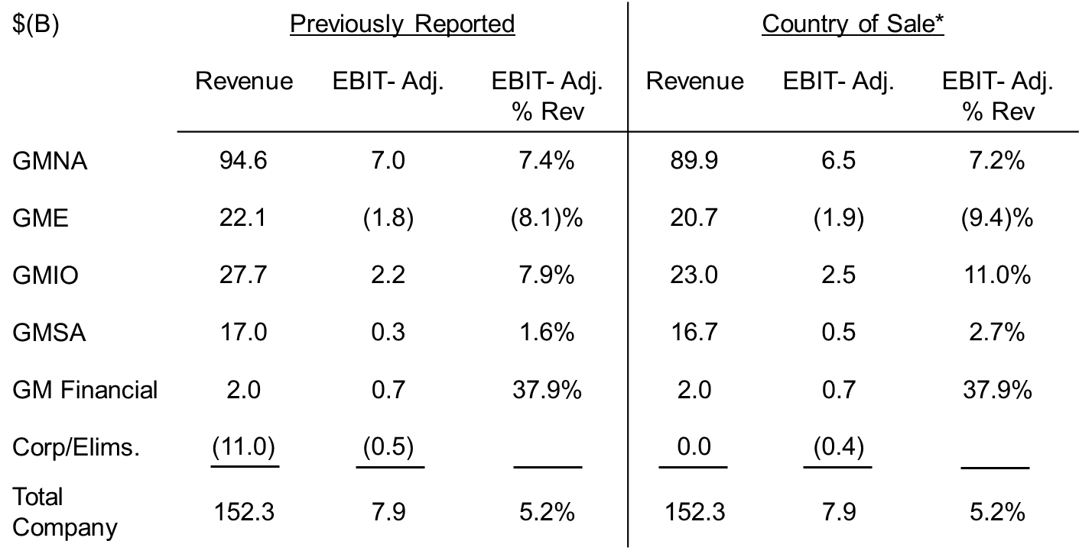
2012 CY Segment Reclassification
* Estimated and Unaudited
Note: EBIT- Adjusted includes GM Financial on an Earnings Before Tax (EBT) basis;
Results may not foot due to rounding

Slide 11
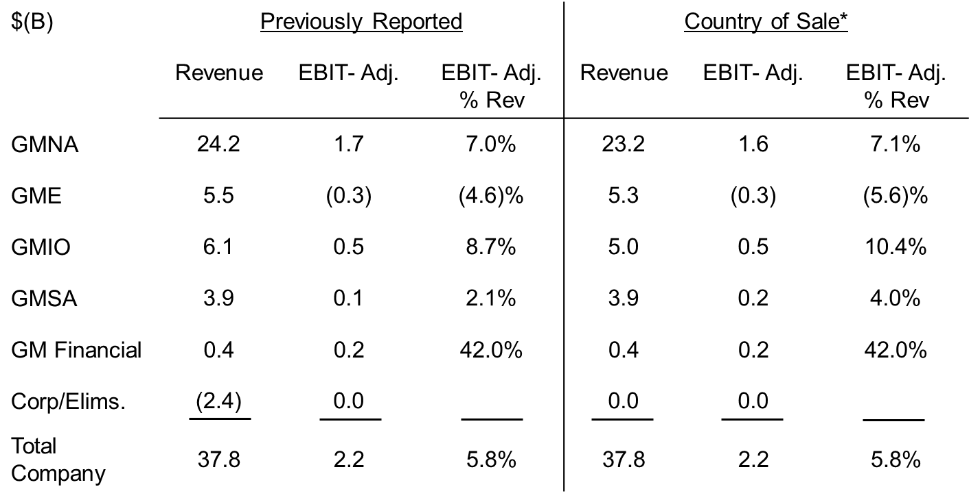
Q1 2012 Segment Reclassification
* Estimated and Unaudited
Note: EBIT- Adjusted includes GM Financial on an Earnings Before Tax (EBT) basis;
Results may not foot due to rounding

Slide 12
Q1 2013 EBIT- Adjusted
EBIT- Adjusted ($B)
* GM Financial at an Earnings Before Tax basis (EBT)

Slide 13
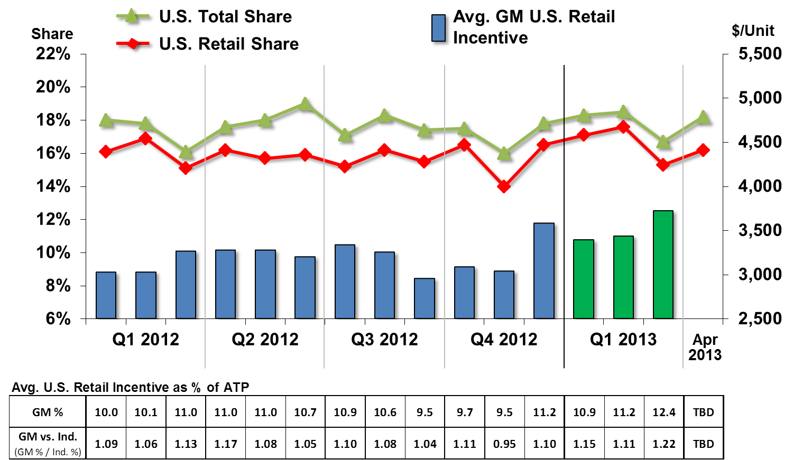
Key GMNA Performance Indicators
Note: Incentive & ATP Information Based on J.D. Power and Associates Power Information Network data

Slide 14
GMNA EBIT- Adjusted
($B)
*
*
* 2012 Q2 - Q4 estimated; all periods unaudited

Slide 15
GMNA EBIT- Adj. – Q1 2012 vs. Q1 2013
($B)
Q1 2012
$0.2B Decrease
Q1 2013
Note: Results may not foot due to rounding

Slide 16
GME EBIT- Adjusted
($B)
⁽¹⁾
⁽¹⁾
⁽²⁾
(1) 2012 Q2 - Q4 estimated; all periods unaudited
(2) Includes Chevrolet Europe

Slide 17
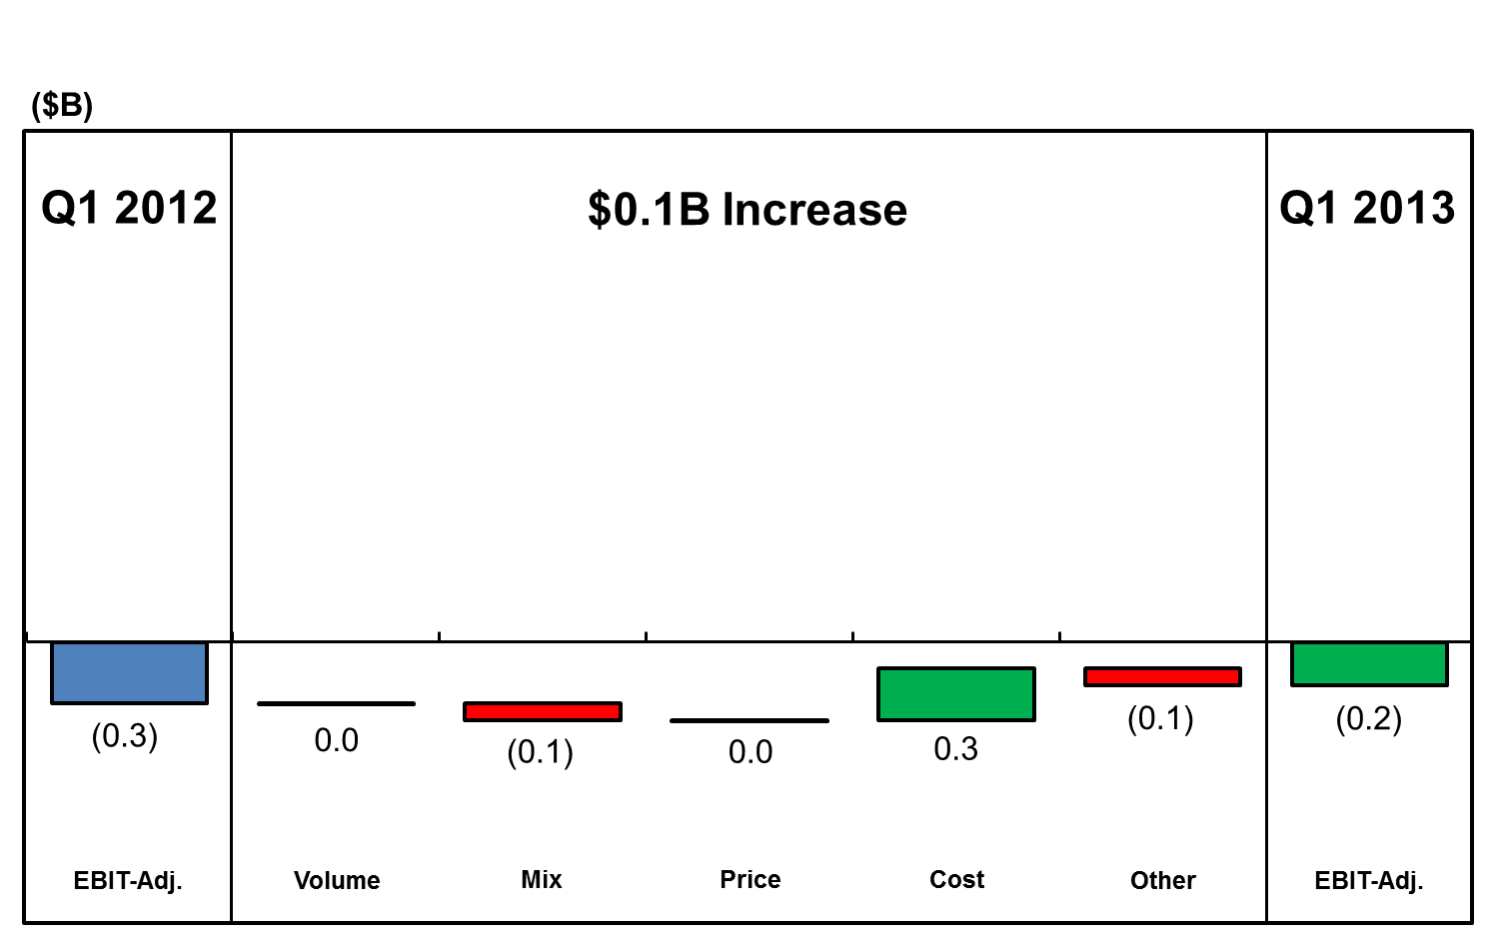
GME EBIT- Adj. – Q1 2012 vs. Q1 2013

Slide 18
GMIO EBIT- Adjusted
($B)
Equity Income
0.6
0.8
0.7
0.5
0.5
(1)
(1)(2)
(3)
(4)
(5)
(1) 2012 Q2 - Q4 estimated; all periods unaudited (2) Excludes equity income and non-controlling interest adjustment
(3) Revenue not consolidated in GM results, pro-rata share of earnings reported as equity income (4) Excludes China JV ‘s
(5) Excludes Chevrolet Europe and Russia

Slide 19
GMIO EBIT- Adj. – Q1 2012 vs. Q1 2013
($B)
Q1 2012
Q1 2013
No Change
Note: Results may not foot due to rounding

Slide 20
GMSA EBIT- Adjusted
($B)
*
*
* 2012 Q2 - Q4 estimated; all periods unaudited

Slide 21
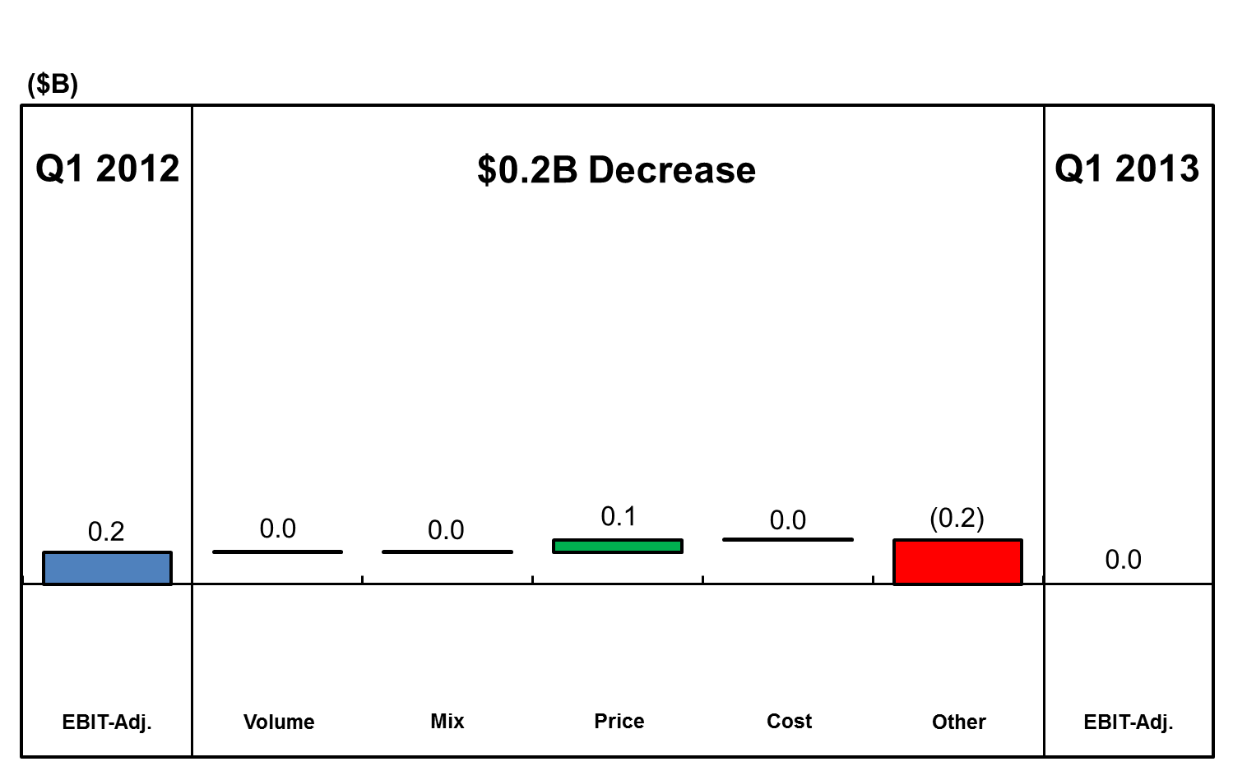
GMSA EBIT- Adj. – Q1 2012 vs. Q1 2013
Note: Results may not foot due to rounding

Slide 22
Adjusted Automotive Free Cash Flow
* Excludes impact of non-cash special items
Note: Results may not foot due to rounding

Slide 23
Key Automotive Balance Sheet Items
Excludes uncommitted facilities
Excludes U.S. non-qualified plan PBO of ~$0.9 billion
March 31, 2012 and March 31, 2013 balances are rolled forward and do not reflect remeasurement, except for the remeasurement of certain GME pension plans in March, 2012
Note: Results may not foot due to rounding

Slide 24
GM Financial
Note: GM Sales Penetrations based on JD Power PIN

Slide 25
2013 CY Considerations
For the calendar year our company effective tax rate (ETR) for earnings purposes is now estimated to be in the high 30’s
  ETR is calculated on income before taxes and before equity income, excluding the effect of special items

Slide 26
General Motors Company
Select Supplemental Financial Information

Slide 27
Global Deliveries
*
Note: GM deliveries include vehicles sold around the world under GM and JV brands, and through GM-branded distribution network.
* International Operations deliveries excludes Chevrolet Europe and Russia
S1

Slide 28
Global Market Share
(1)
(2)
Note: GM market share includes vehicles sold around the world under GM and JV brands, and through GM-branded distribution network. Market share data excludes the markets of Iran, North Korea, Sudan and Syria.
Europe share includes Chevrolet Europe
(2) International Operations share excludes Chevrolet Europe and Russia
S2

Slide 29
Operating Income Walk to EBIT- Adjusted
Note: EBIT-Adj. includes GM Financial on an Earnings Before Tax (EBT) basis
Note: Results may not foot due to rounding
S3

Slide 30
Reconciliation of EBIT- Adjusted
Note: EBIT-Adj. includes GM Financial on an Earnings Before Tax (EBT) basis; Results may not foot due to rounding

Slide 31
Restructuring (not included in special items)
Note: Results may not foot due to rounding

Slide 32
GM Financial – Key Metrics
(1)
(2)
Includes $47M in outstanding loans to dealers that are majority-owned and consolidated by GM, in connection with our commercial lending program
Excludes consumer finance receivables in repossession

